Slide 1
PUBH 898: Health Economics Finding data and statistics

Slide 2
Sources - Canada
Statistics Canada: Federal statistical agency
Data released under Data Liberation Initiative (DLI) license
Surveys/ Aggregate data
Survey data obtained under DLI can only be used for research purposes
CIHI
Health care system level data [Aggregate]

Slide 3
Statistics
Canada
Make
Data
Anonymous
Web-based Extractors
Public Use Microdata Files
(PUMF)
<odesi>
Equinox
Surveys/ Admin Data
DLI License
Research Data Centre
Create Tables
Free
Aggregate Data
CANSIM
Census
Submit Proposal
Open License

Slide 4
Survey Data [Microdata]
List of available public use microdata files >>
Use extractors:
ODESI [recommended]
EQUINOX

Slide 5
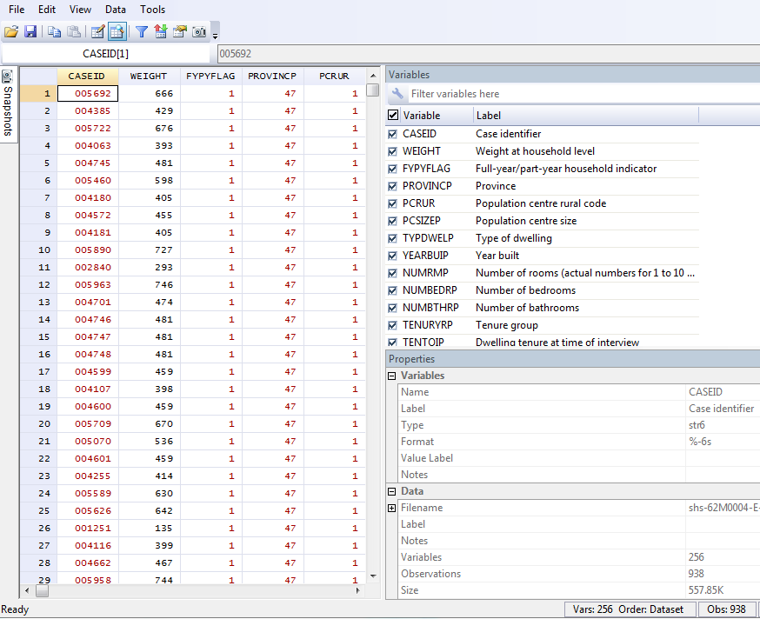
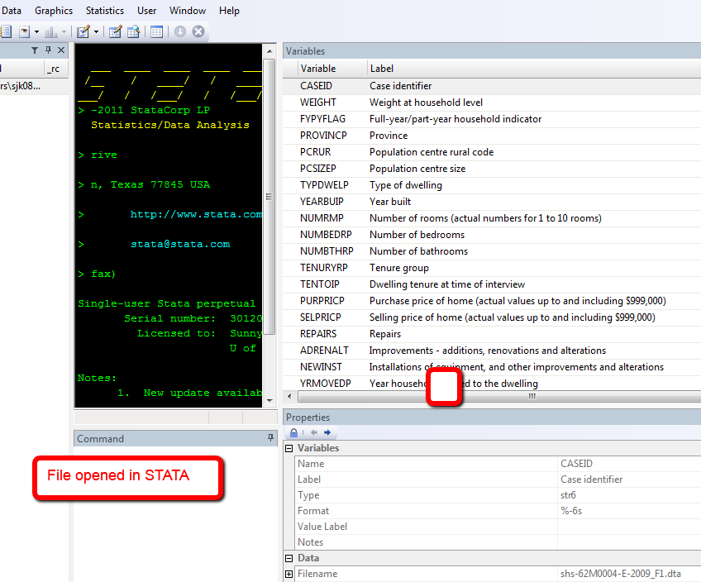
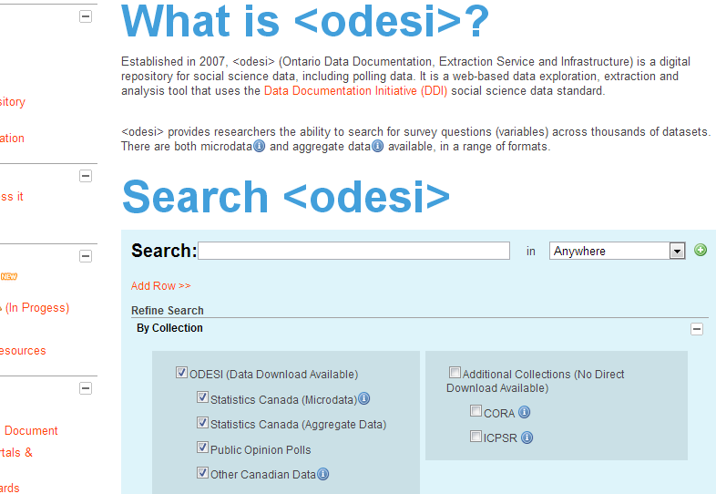
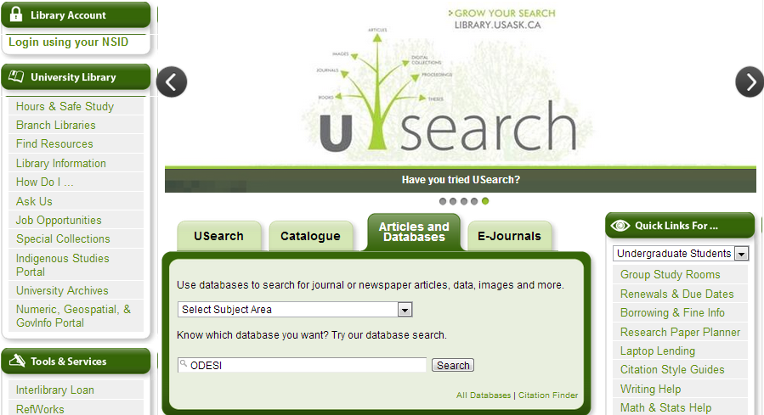
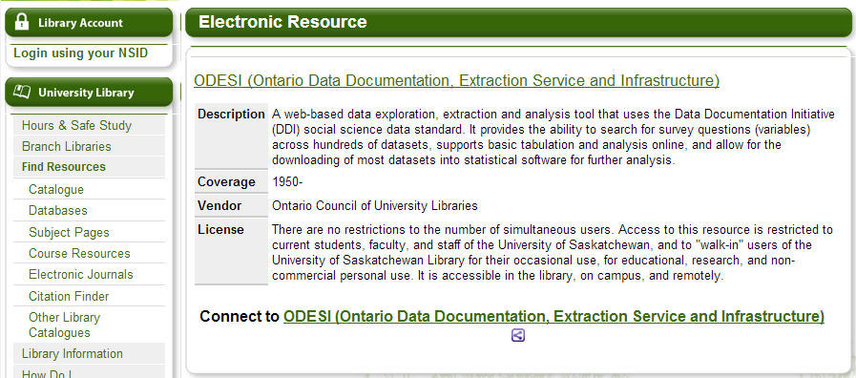
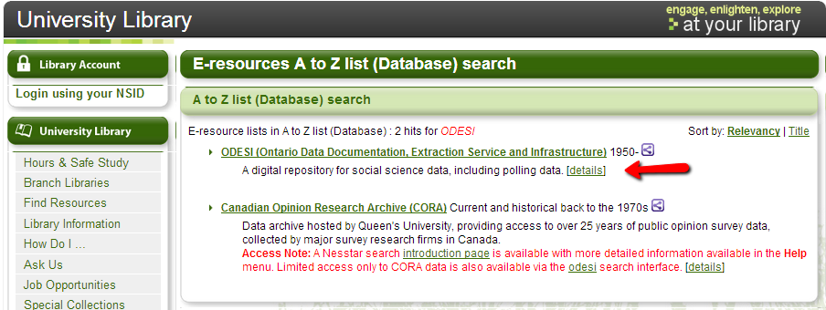
Survey Data
Extract using <odesi>

Slide 6
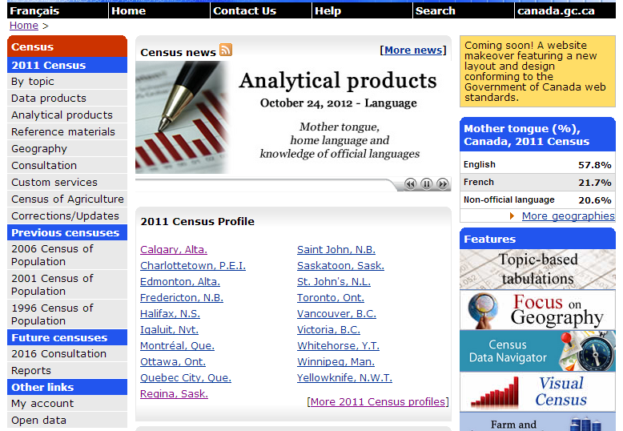
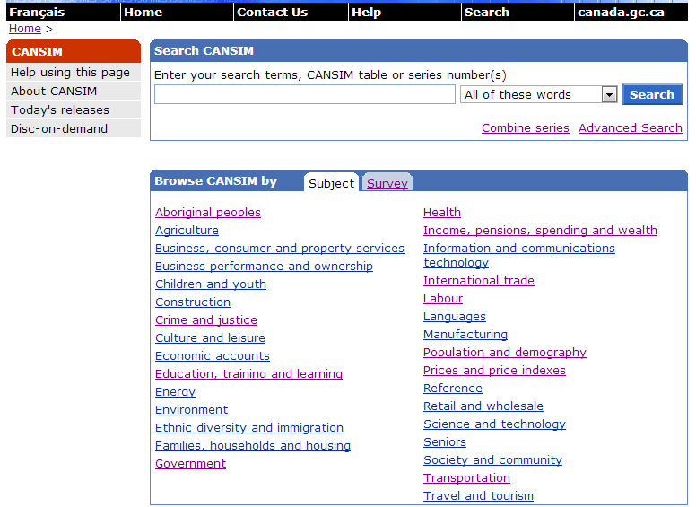
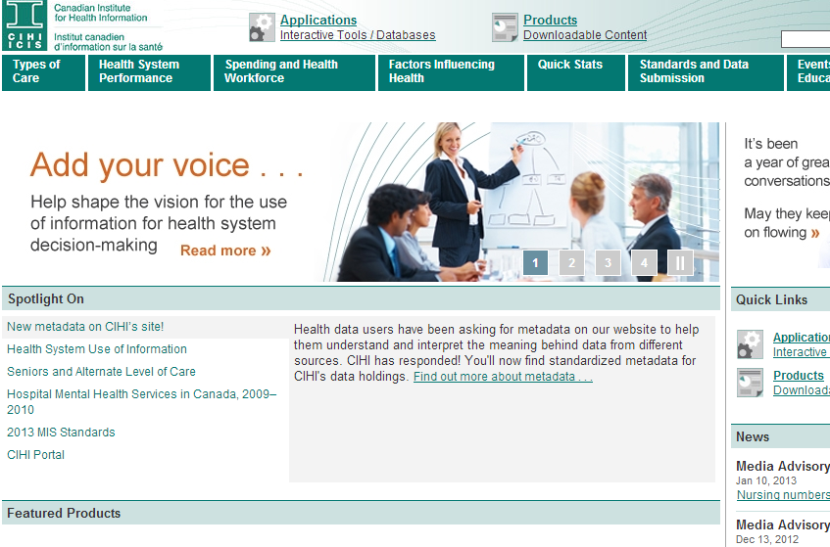
Aggregate Data
CANSIM: Canadian Socio-Economic Information Management System
Census: Socio-demographic information at different levels of geography
CIHI – Canadian Institute for Health Information
Data at the level of the health care system

Slide 7
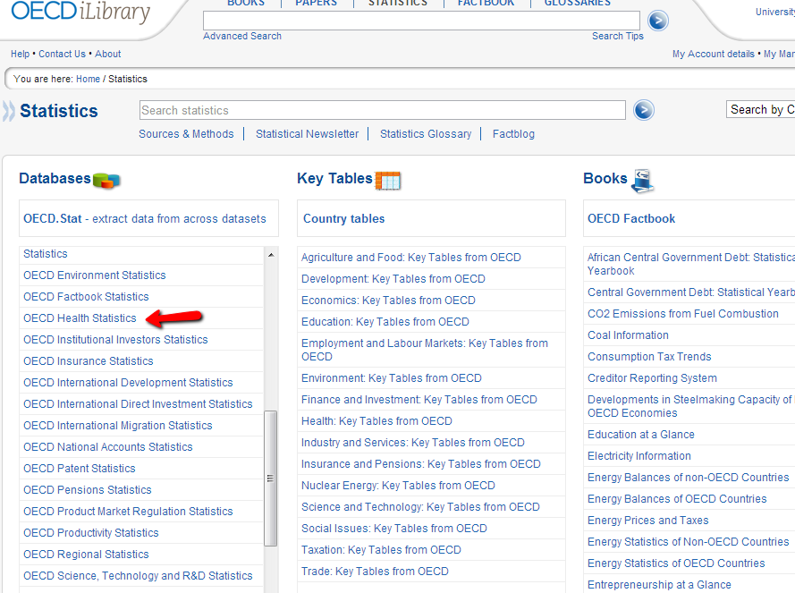
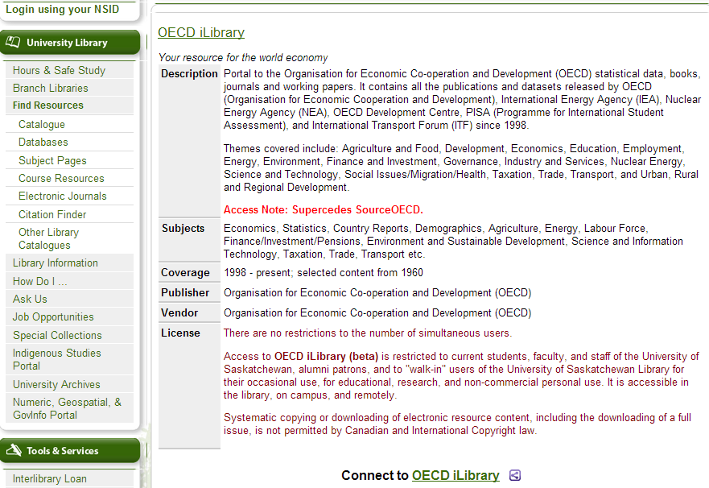
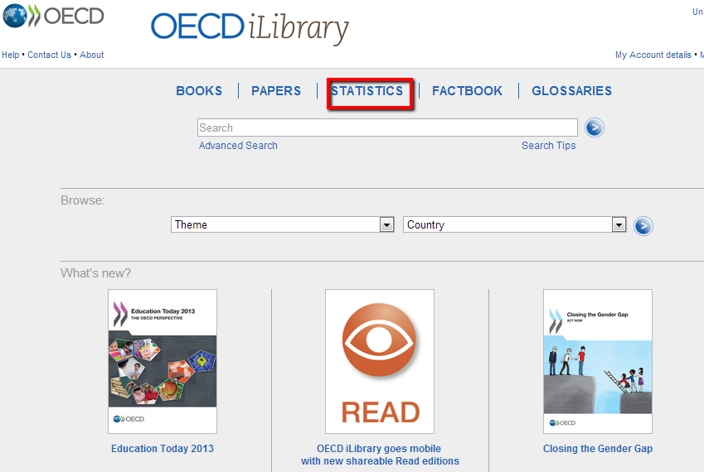
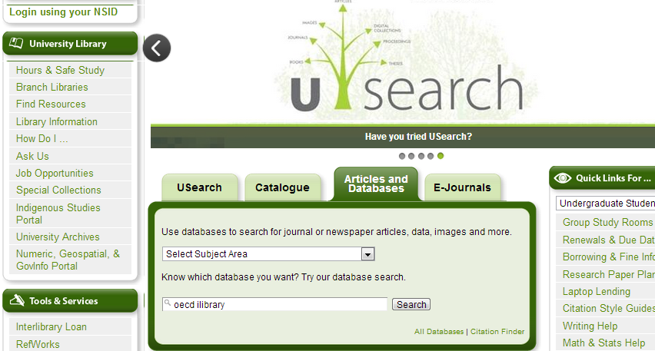
International
OECD iLibrary

Slide 8
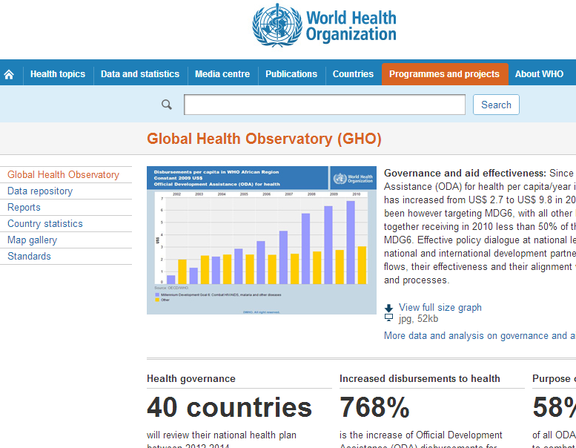
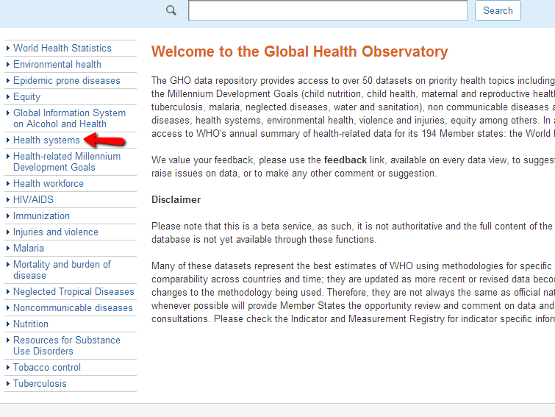
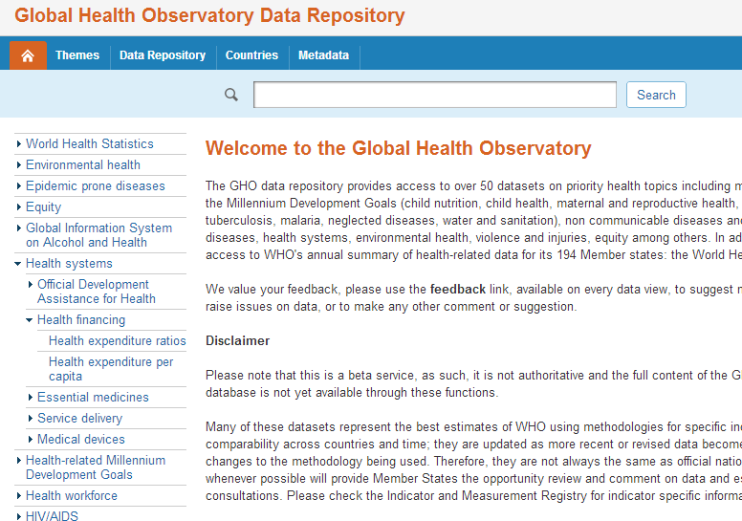
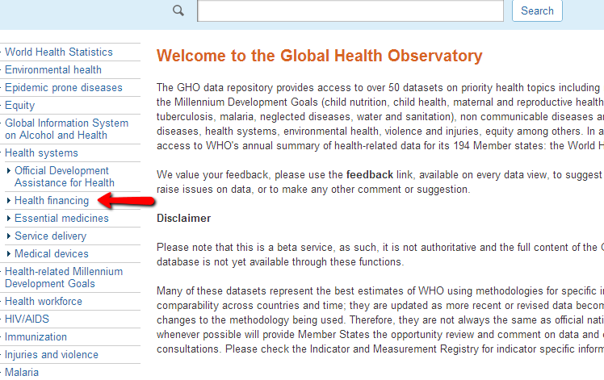
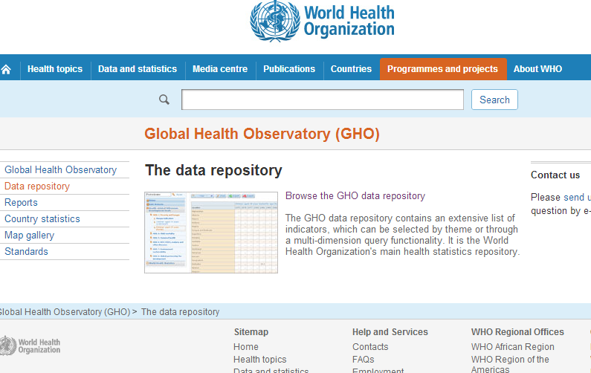
International
Global Health Observatory – World Health Organization

Slide 9
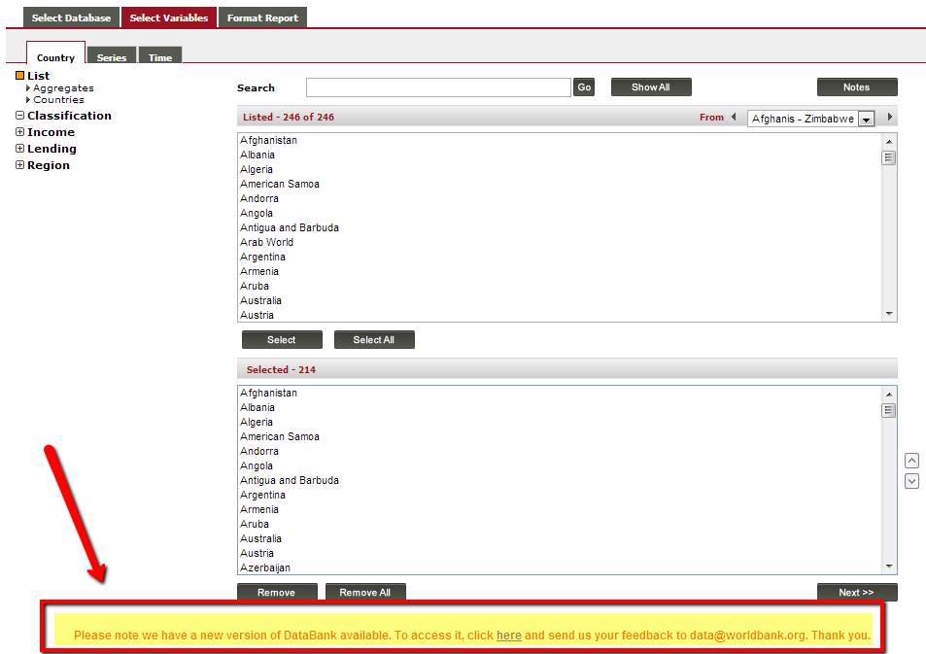
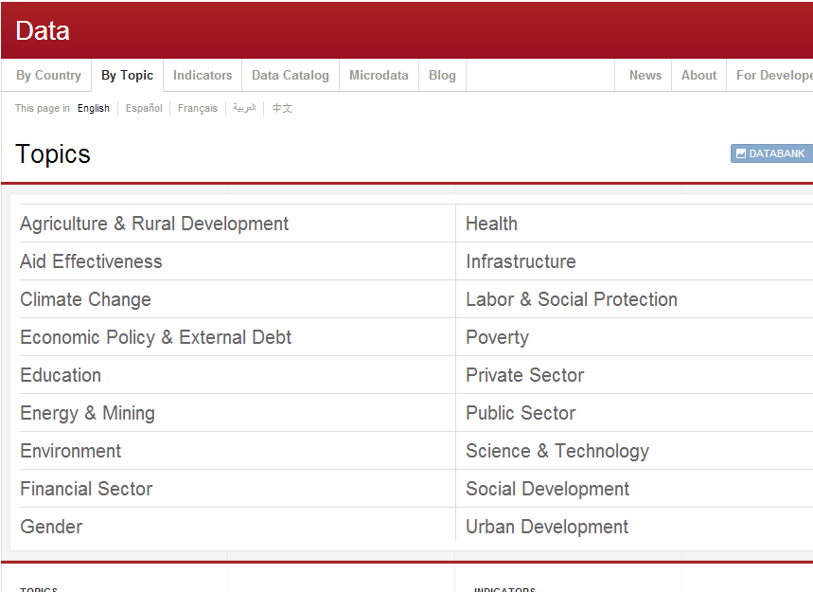
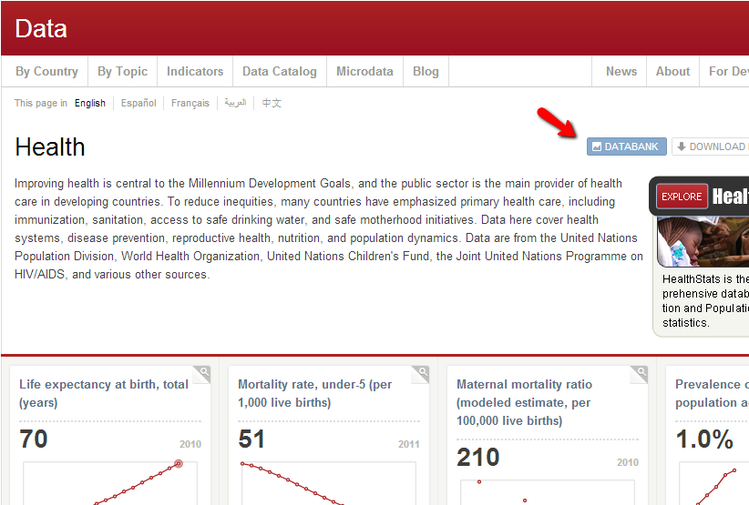
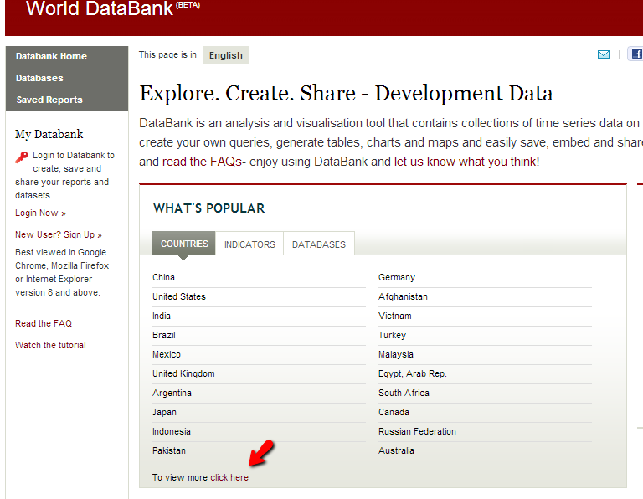
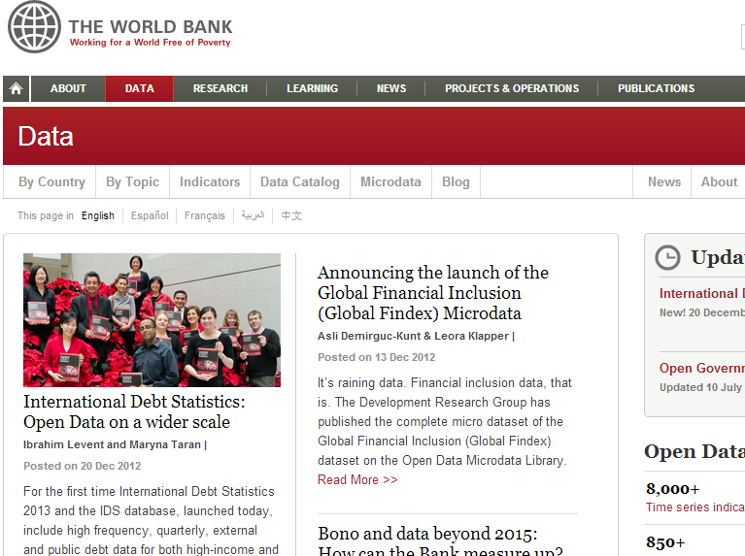
International
World Bank

Slide 10
Contact Us
Sunny Kaniyathu
306 966 8841; sunny.kaniyathu@usask.ca
Winnie Smit
306 966 7261; winnie.smit@usask.ca
Location: 228/ 230 Murray Library

