Slide 1
RRM 321: Resource Data and Environmental Modeling Finding statistics

Slide 2
Canada
Statistics Canada
Environment Canada
Natural Resources Canada

Slide 3
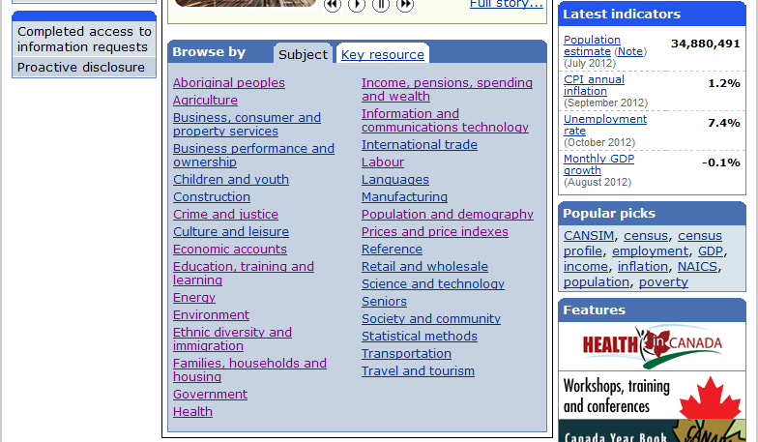
Statistics Canada
Webpage http://www.statcan.gc.ca/
Data Tables from CANSIM database

Slide 4
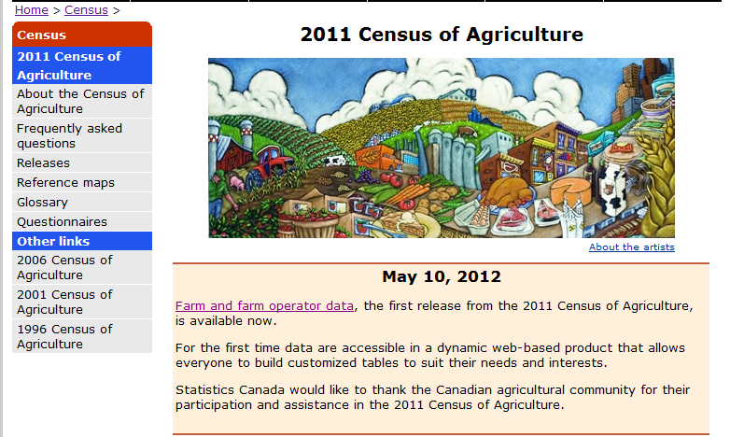
Statistics Canada
Census of Agriculture http://www.statcan.gc.ca/ca-ra2011/index-eng.htm
Farm data and Farm operator data

Slide 5
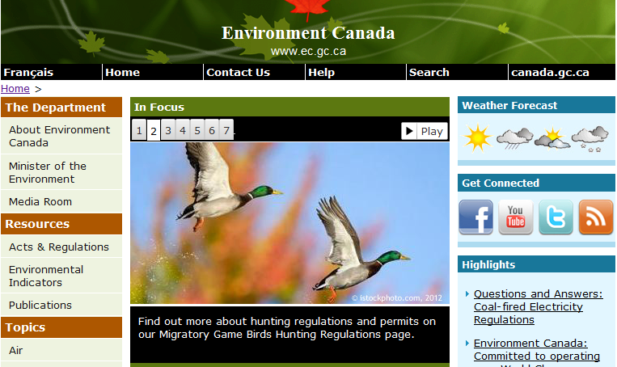
Environment Canada
Environmental indicators
http://www.ec.gc.ca/indicateurs-indicators/
Water, Air quality
Climate, emissions
National Pollutant Release Inventory
http://www.ec.gc.ca/inrp-npri/
Climate Data Online: Weather
http://climate.weatheroffice.gc.ca/climateData/canada_e.html

Slide 6
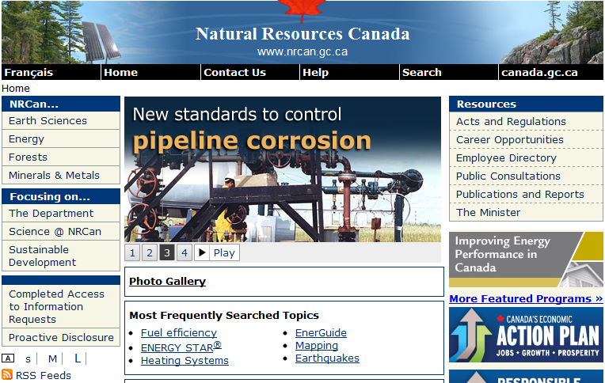
Natural Resources Canada
http://www.nrcan.gc.ca/home
Earth Sciences
Energy
Forests
Minerals and Metals

Slide 7
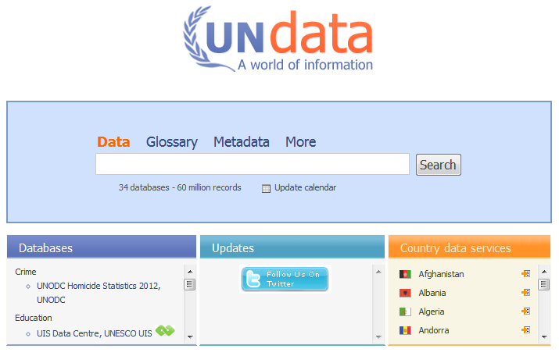
International
UNdata
http://data.un.org/Explorer.aspx

Slide 8
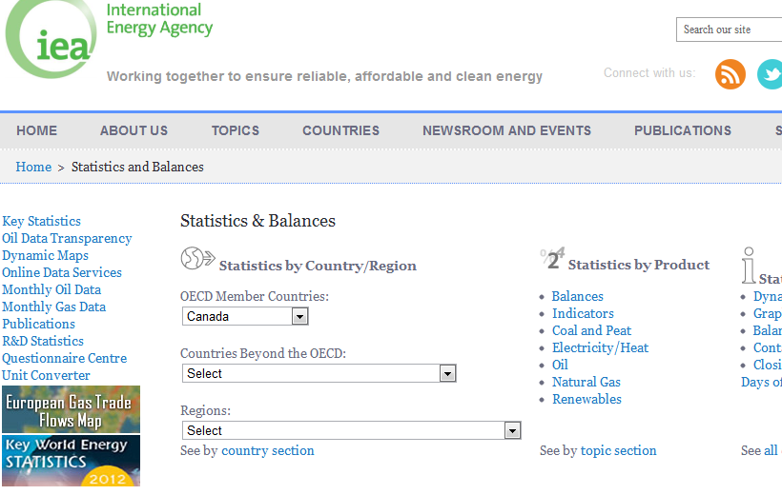
International
International Energy Agency >>

Slide 9
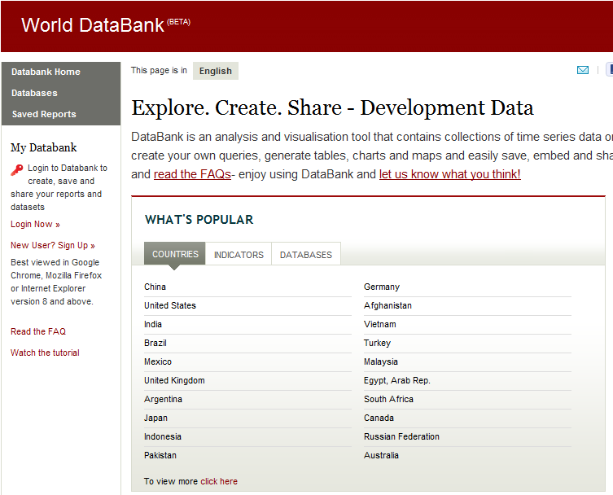
International
World Bank Data

Slide 10
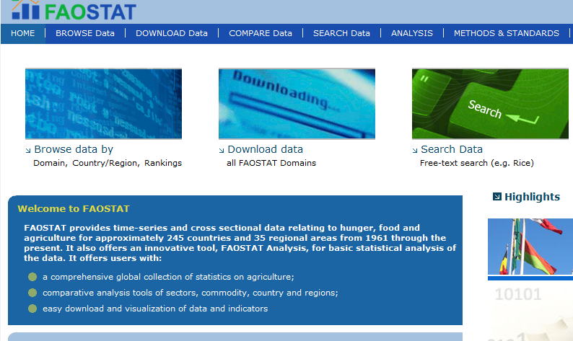
International
FAOSTAT and AQUASTAT
http://faostat3.fao.org/home/index.html

Slide 11
Contact Us
Sunny Kaniyathu
306 966 8841; sunny.kaniyathu@usask.ca
Winnie Smit
306 966 7261; winnie.smit@usask.ca

